Slide 1
BITS Pilani presentation
K. Venkata Ratnam
Mathematics

Slide 2
Course Number : SS ZC416
Course Title: MATHEMATICAL FOUNDATIONS
FOR DATA SCIENCE
Lecture No. :7

Slide 3
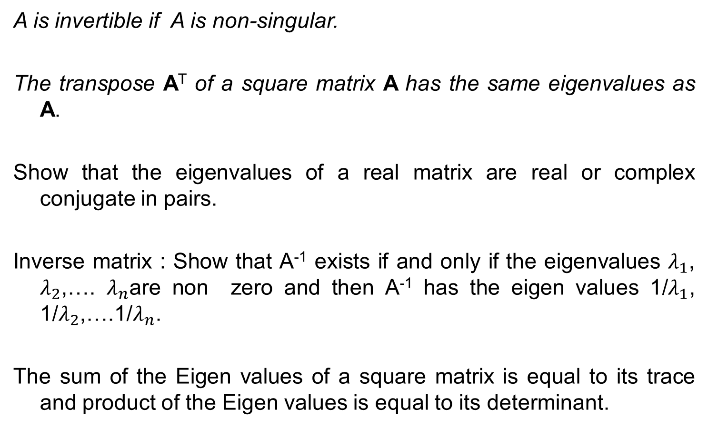
Theorems
A is invertible if A is non-singular.
The transpose A^{T} of a square matrix A has the same eigenvalues as A.
Show that the eigenvalues of a real matrix are real or complex conjugate in pairs.
Inverse matrix : Show that A⁻¹ exists if and only if the eigenvalues $λ_{1}$, $λ_{2}$,…. $λ_{n}$are non zero and then A⁻¹ has the eigen values 1/$λ_{1}$, 1/$λ_{2}$,….1/$λ_{n}$.
The sum of the Eigen values of a square matrix is equal to its trace and product of the Eigen values is equal to its determinant.

Slide 4
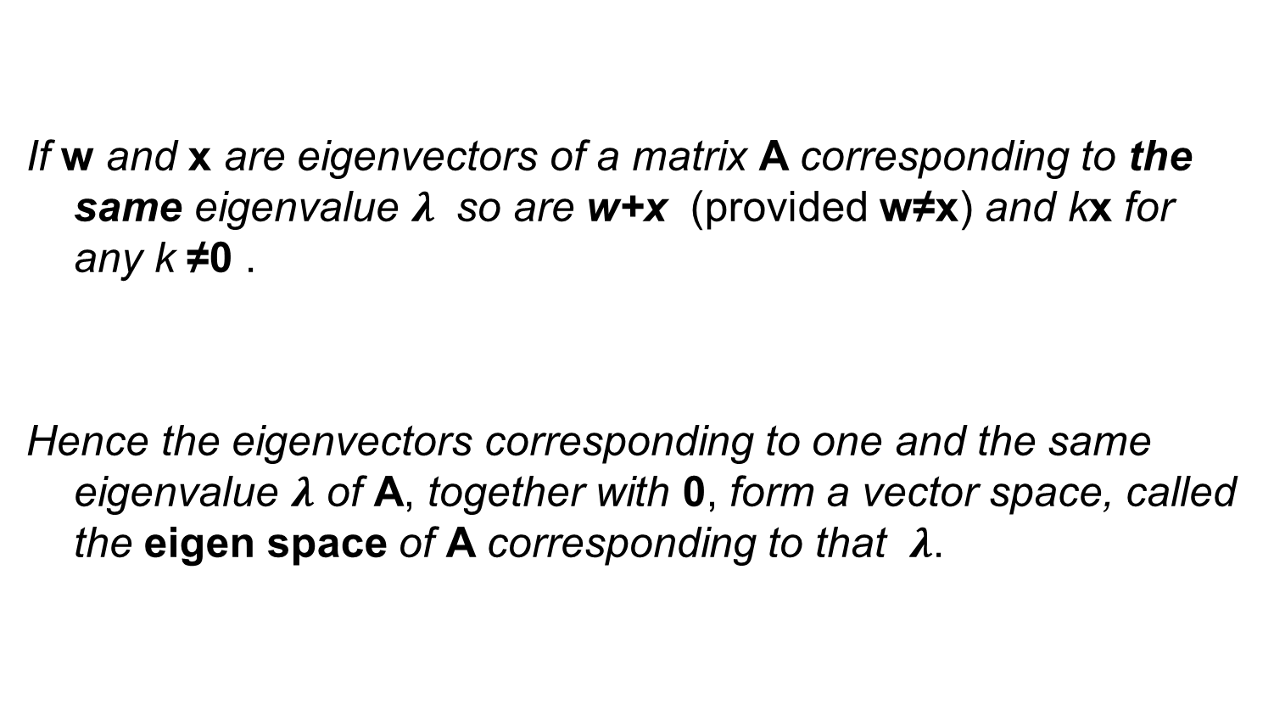
Eigenvectors, Eigen space
If w and x are eigenvectors of a matrix A corresponding to the same eigenvalue $λ$ so are w+x (provided w≠x) and kx for any k ≠0 .
Hence the eigenvectors corresponding to one and the same eigenvalue $λ$ of A, together with 0, form a vector space, called the eigen space of A corresponding to that $λ$.

Slide 5
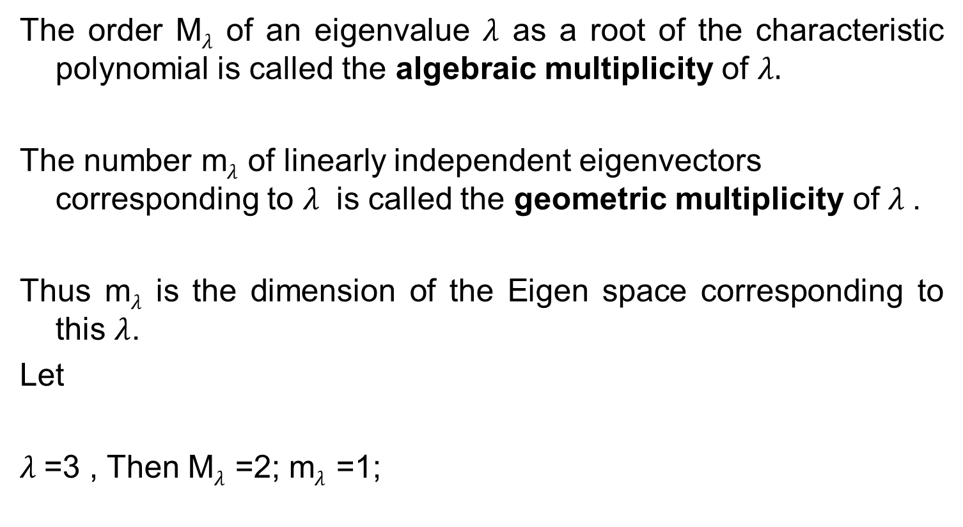
Algebraic multiplicity
Geometric multiplicity
The order M$λ$ of an eigenvalue $λ$ as a root of the characteristic polynomial is called the algebraic multiplicity of $λ.$
The number m$λ$ of linearly independent eigenvectors corresponding to $λ$ is called the geometric multiplicity of $λ$.
Thus m$λ$ is the dimension of the Eigen space corresponding to this $λ$.
Let
$λ$=3 , Then M$λ$ =2; m$λ$ =1;

Slide 6

Defect
Since the characteristic polynomial has degree n, the sum of all the algebraic multiplicities must equal n. In general, m$λ$ $≤$ M$λ$ , the difference $∆_{λ}$= M$λ$ - m$λ$ is called the defect of $λ$.

Slide 7
Todays Lecture
Gauss elimination with scaling and partial pivoting

Slide 8
Introduction
The basic method for solving systems of linear equations by Gauss elimination and back substitution was already studied. What is the need to study further:
The reason is that here we cover Gauss elimination in the
setting of numeric’s and introduce new material such as pivoting, row scaling, and operation count.
Furthermore, we give an algorithmic representation of Gauss elimination that can be readily converted into software.
We also show when Gauss elimination runs into difficulties with small pivots and what to do about it.

Slide 9
System of Equations

Slide 10
System of Equations
A solution of (1) is a set of numbers x₁,x₂,…,x_{n} that satisfy all the n equations, and a solution vector of (1) is a vector x whose components constitute a solution of (1).

Slide 11
Gauss Elimination
This standard method for solving linear systems (1) is a systematic process of elimination that reduces (1) to triangular form because the system can then be easily solved by back substitution.
How do we reduce a given system (1) to triangular form?

Slide 12
Gauss Elimination
First step :
Eliminate x₁ from equations E₂ to E_{n} in (1).
We do this by adding (or subtracting) suitable multiples E₁ of to (from) equations E₂ , E₃ , …., E_{n} and taking the resulting equations E₂* , E₃ *, ..,E_{n} *, call them as the new equations.
The first equation E₁, is called the pivot equation in this step, and a₁₁ is called the pivot. This equation is left unaltered.
Second step:
we take the new second equation E₂* (which no longer contains as the pivot equation and use it to eliminate x₂ from E₃ * to E_{n} *, and so on.

Slide 13
Gauss Elimination
After n-1 steps this gives a triangular system that can be solved by back substitution as just shown. In this way we obtain precisely all solutions of the given system.
The pivot a_{kk} (in step k) must be different from zero and should be large in absolute value to avoid roundoff magnification by the multiplication in the elimination.
For this we choose as our pivot equation one that has the absolutely largest a_{jk} in column k on or below the main diagonal (actually, the uppermost if there are several such equations). This popular method is called partial pivoting.
Partial pivoting distinguishes it from total pivoting, which involves both row and column interchanges but is hardly used in practice.

Slide 18
Scaling
It has been observed that if the elements of the coefficient matrix A vary greatly in size, then it is likely that large loss of significance errors will be introduced and the propagation of rounding errors will be worse. To avoid this problem, we usually scale the matrix A so that the elements vary less. This is usually done by multiplying the rows and columns by suitable constants.

Slide 19
Row scaling
The multiplication of each Row j by a suitable scaling factor It is done in connection with partial pivoting to get more accurate solutions. Despite much research (see Refs. [E9], [E24] in App. 1) and the proposition of several principles, scaling is still not well understood. As a possibility, one can scale for pivot choice only (not in the calculation, to avoid additional roundoff) and take as first pivot the entry for which is largest; here is an entry of largest absolute value in Row j. Similarly in the further steps of the Gauss elimination.

Slide 20
Operation Count
Quite generally, important factors in judging the quality of a numeric method are:
Amount of storage
Amount of time (=number of operations)
Effect of roundoff error
For the Gauss elimination, the operation count for a full matrix (a matrix with relatively many nonzero entries) is as follows.

Slide 21
Operation Count
In Step k we eliminate x_{k} from ‘n-k’ equations. This needs ‘n-k’ divisions in computing the m_{jk} (line 3) and (n - k)(n- k +1) multiplications and as many subtractions (both in line 4).
Since we do n-1 steps, k goes from 1 to n-1 and thus the total number of operations in this forward elimination is

Slide 22
Operation Count

Slide 23
Problems
1. Solve graphically and explain geometrically :
7.2x-3.5y=16
-14.4x+7.0y=31.0
Solution: x/2.222 –y/4.571=1
-x/2.152+y/4.428=1
There is no intersection of the equation, no solution.

Slide 24
Problem
2. Find a and b such that a x + y = b, x + y = 3, has i) a unique solution ii) infinitely many solutions iii) no solution.

Slide 25
3. Solve the following linear system by gauss elimination with partial pivoting 5x +3y + z = 2, -4y + 8z = -3, 10x - 6y + 26z = 0
E₁<->E₃
|a₁₁ |<|a₃₁|

Slide 26
Algorithm format

Slide 27
Solve
Problem 4: 5x + 3y + z = 2; -4y + 8z = -3, 10x - 6y + 26z = 0

